Slide 1
Using Azure Functions for data processing
Benjamin Kettner, 2020-10-13, dataMinds Connect

Slide 2
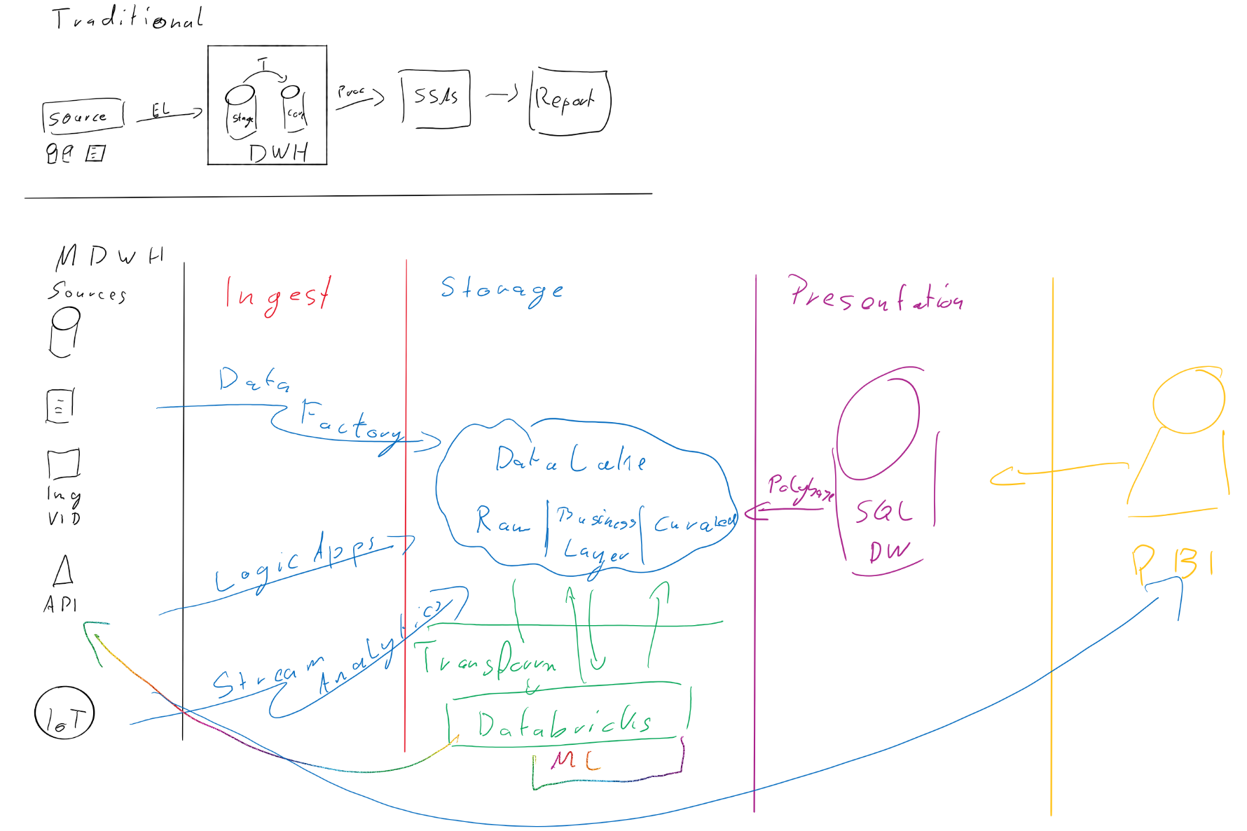

Slide 3
An introduction I
Azure Functions…
… are triggered by events.
… offer many different triggers.
… can be classified as „Compute-on-demand“.
… can be implemented in different languages.
… are serverless,
… but are still able to handle state.

Slide 4

An introduction II
I…
… am from Berlin.
… am CTO of ML!PA Consulting.
… did a PhD in applied mathematics (a long time ago in a galaxy far away).
… am a Microsoft MVP since June 2020.
… leader of our local PASS chapter.
… music and data nerd and father.

Slide 5
Why do I like „serverless“?
Serverless computing…
… takes the PaaS idea to the next level.
… takes the woes of
management,
scalability and
provisioning of compute power from you.
… allows you to pay (only) for your consumption.

Slide 6
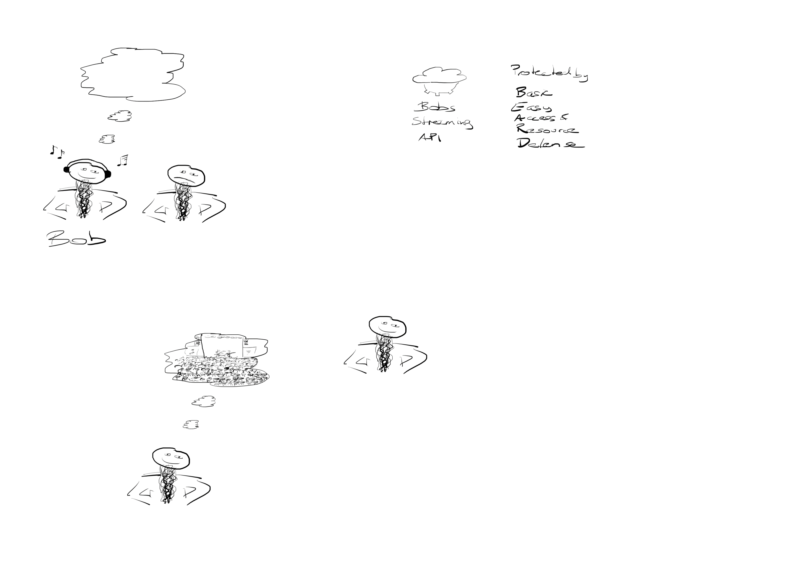
How about an example?
Bob
Friendly guy
Impressive beard

Slide 7
How about an example?
Bob
Friendly guy
Impressive beard
Music fan

Slide 8
How about an example?
Bob
Friendly guy
Impressive beard
Music fan

Slide 9
How about an example?
Bob
Friendly guy
Impressive beard
Music fan

Slide 10
How about an example?
Bob
Friendly guy
Impressive beard
Music fan

Slide 11
How about an example?
Bobs music streaming API
Bob
Friendly guy
Impressive beard
Music fan/geek

Slide 12
How about an example?
Bobs music streaming API
Secured with
Basic
Easy
Access
Resource
Defense
Bob
Friendly guy
Impressive beard
Music fan/geek

Slide 13
How about an example?
Bobs music streaming API
Secured with
Basic
Easy
Access
Ressource
Defense
Bob
Friendly guy
Impressive beard
Music fan/geek

Slide 14

Demo-Time

Slide 15


Data extraction strategies I: All ADF
Auth
Beard
Get PL
Azure Data Factory
[Songs]
Get Band
Get Song
Foreach SongID

Slide 16
Effects of I
Error Handling 100% in ADF
Required during entire process: Integration Runtime (expensive)
Timeout handling if requests „hang“
Streamlinging/parallelism
Fully synchronous process (fetching Bands will only start after Songs were fetched)
CAN WE DO BETTER?

Slide 17

Data extraction strategies II: All Function
Auth
Beard
Get PL
Init
[Songs]
Get Band
Get Song
Foreach SongID
Azure Data Factory

Slide 18
Effects of II
Error Handling in both ADF and Function
Required only during initialization: Integration Runtime (expensive)
Timeout handling if requests „hang“ problematic
Streamlinging/parallelism via threading (not nice)
Fully synchronous process (fetching Bands will only start after Songs were fetched)
CAN WE DO BETTER?

Slide 19

Data extraction strategies III: Async Function
Auth
Beard
Get PL
Init
[Songs]
Band
Get Song
Storage Queue
Get Song
Get Song
Azure Data Factory
Get Band
Get Band
Get Band

Slide 20
Effects of III
Error Handling in both ADF and Function
Required only during initialization: Integration Runtime (expensive)
No Timeout handling required due to small requests
Resiliency (if one „GetBand“ fails all others can still run)
Streamlinging/parallelism via fan-out (very nice)
Fully asynchronous process
CAN WE DO BETTER?

Slide 21
Improvement of III
Assuming that Band Ids do not change, do we need to fetch the band from the API (slow!!) each time?
No, we can access the database (slightly better but what about connection limits and fanout?)
Or we can use DURABLE ENTITIES.

Slide 22
Demo-Time

Slide 23
Wrap-Up
Functions are useful in many scenarios
Availability of triggers makes them flexible helpers
Patterns:
Queues for asynchroneous data processing
Queues for nested REST queries
Durable functions to reduce DB or API calls
Any Ideas/Suggestions? Please get in touch:
E-Mail: benjamin.kettner@ml-pa.com
Twitter: @DataMonsterBen

